Slide 1
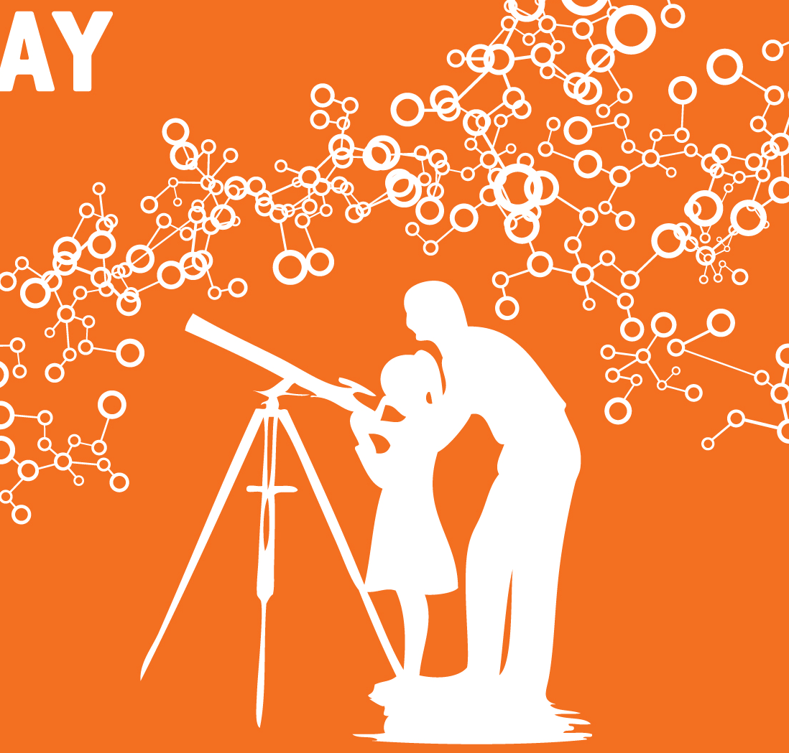

European Science Education Academy
Sofoklis Sotiriou
Ellinogermaniki Agogi
European Physical Society

Slide 2
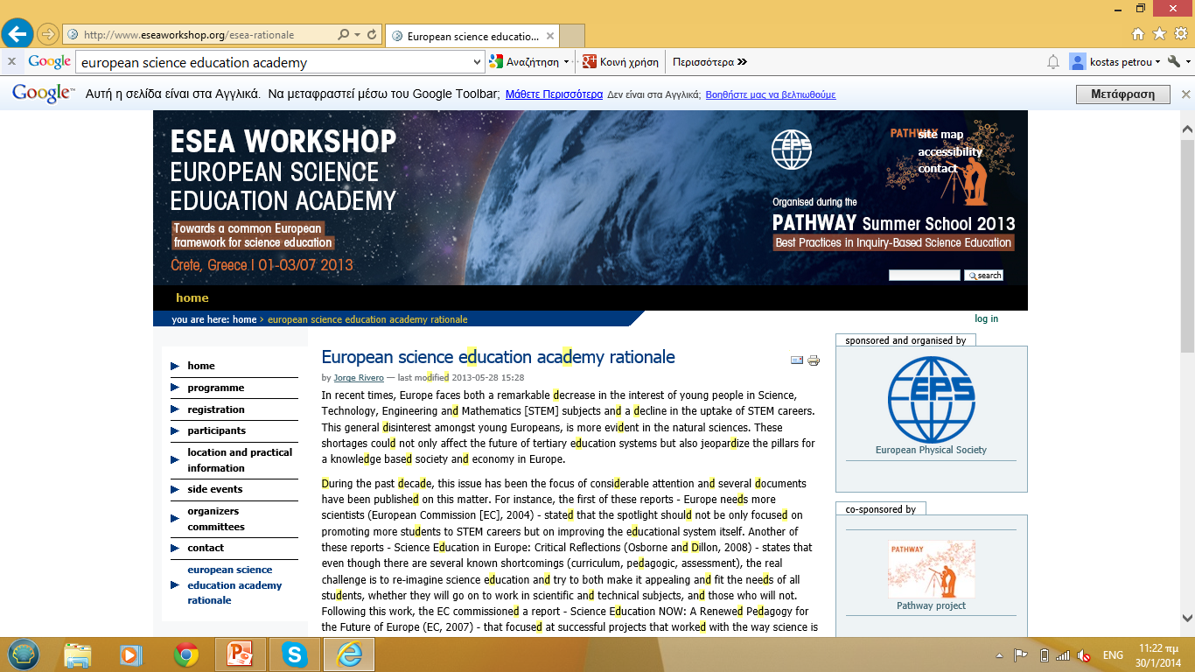
Motivation, purpose
European Science Education Academy
Place EPS squarely in the shaping of physics teaching approaches
Document the innovation process in science education (focusing on teachers PD) in Europe
Collect, organise and provide easy access best practices in science education
Produce data about science education in Europe
Policy advice and input
Coordinate the actions of the National Societies

Slide 3
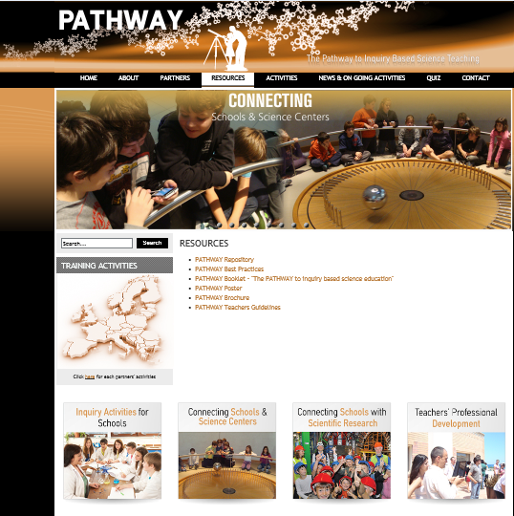
Starting Point: Presentation of the Main PATHWAY Documentation
Pedagogical Framework
Best Practices
Guidelines for Teachers

Slide 4
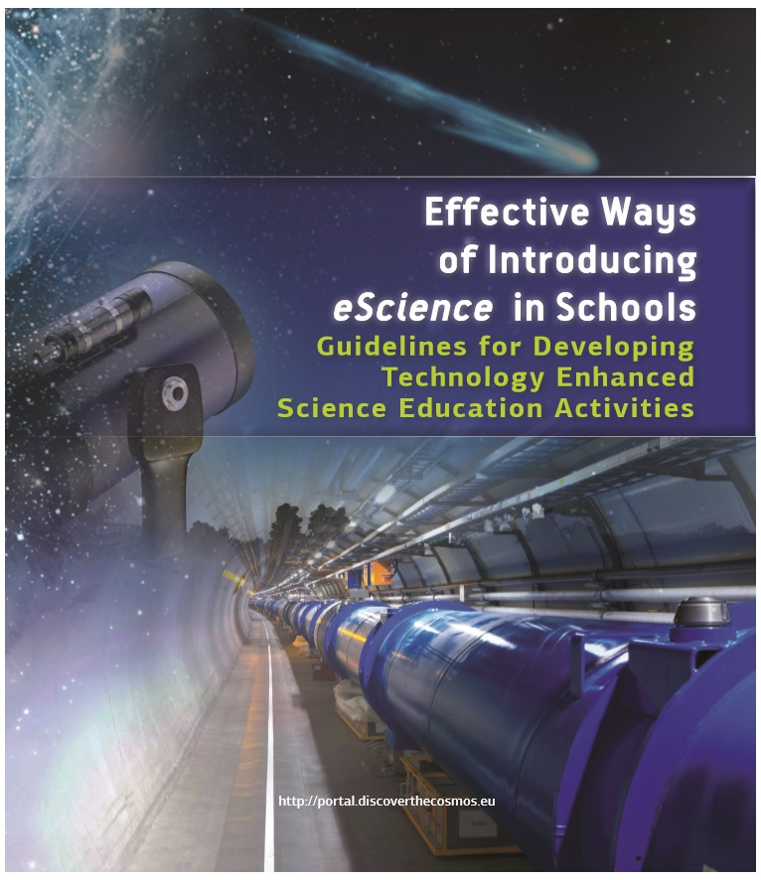

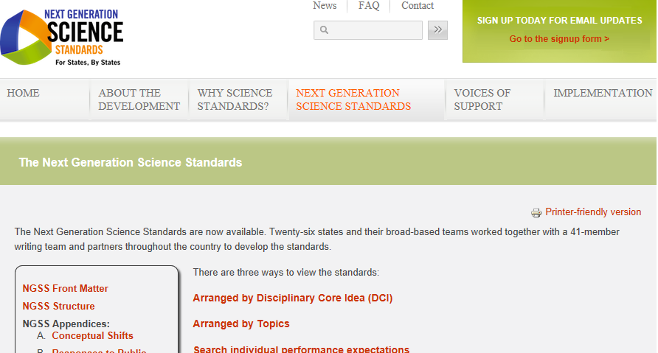
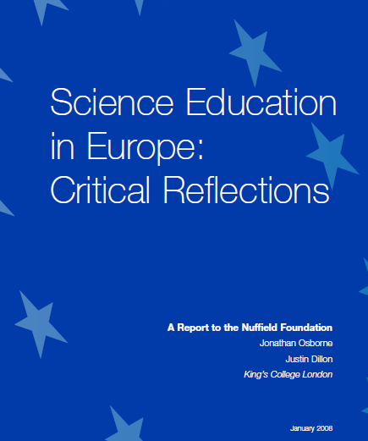
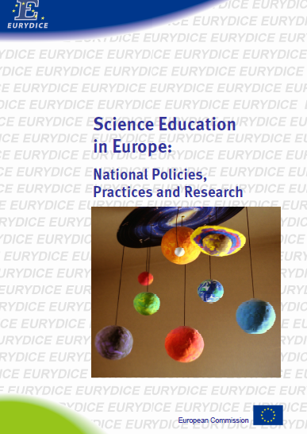
Presentations of Experts Views – Reviews of relevant materials - Surveys

Slide 5
Recommendations
Documentation Center for the Modernization of Science Education
Publications, Research Work, Conferences and Workshops
Developing Effective Training Programmes
- Guidelines, Resources, Best Practices
Supporting Communities of Practice
Organising Resources, Motivating Practitioners
Dissemination and Networking
- Supporting National Physical Societies, Collaboration with EC, ESERA, GIREP

Slide 6
Development of the ESEA Repository
For policy makers
For science education experts
For teachers
For museum educators and outreach groups

Slide 7
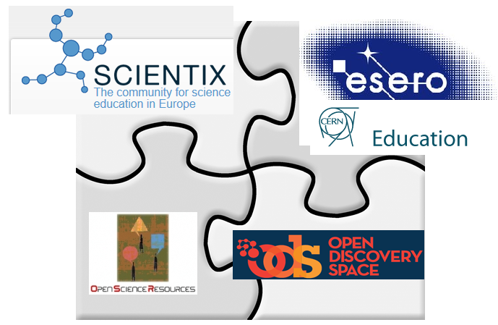
Support of the development of a distributed repository for Science Education in Europe

Slide 8
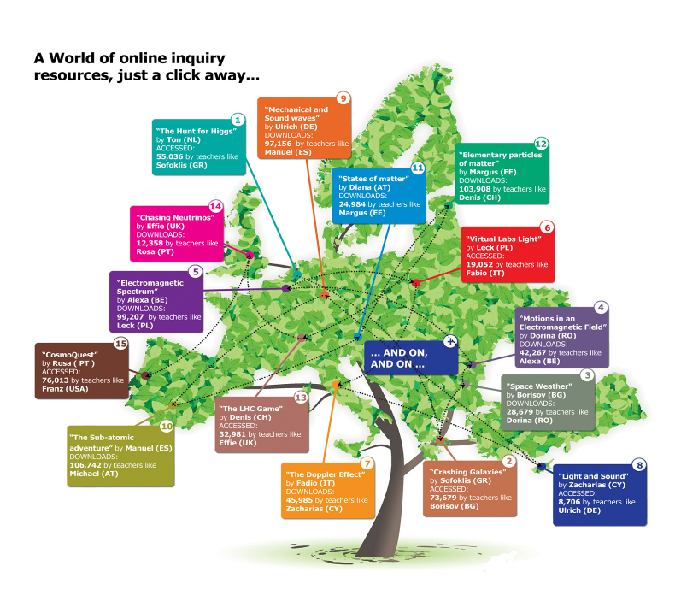
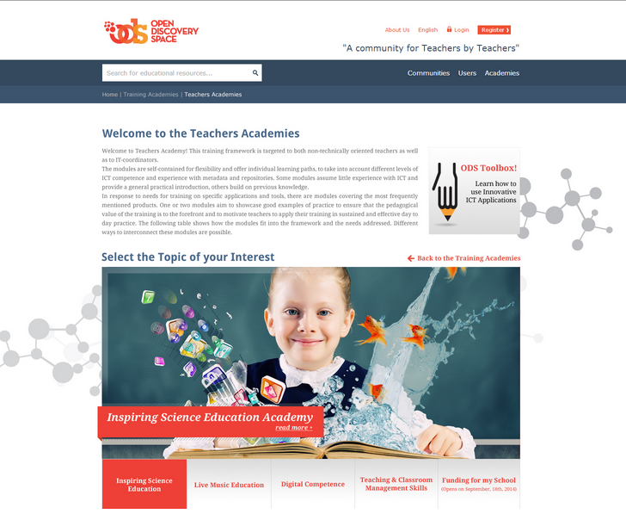
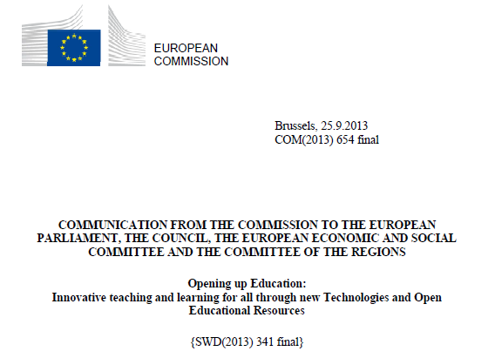


A World of eLearning tools and resources for Scientific Disciplines
just a click away…

Slide 9
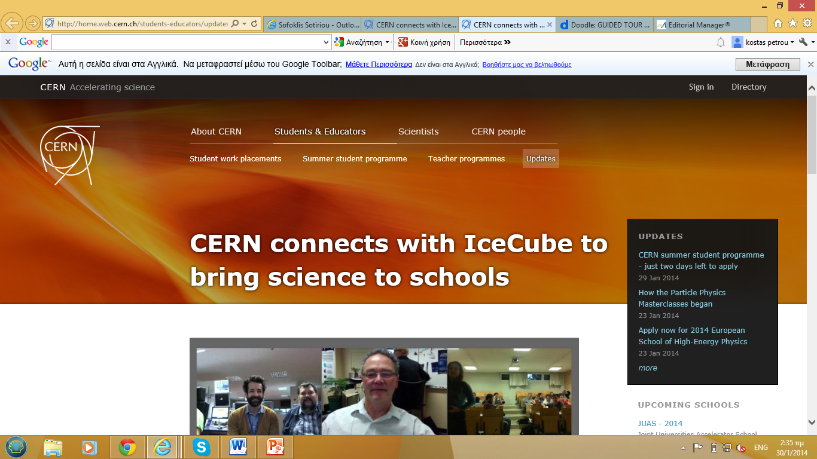
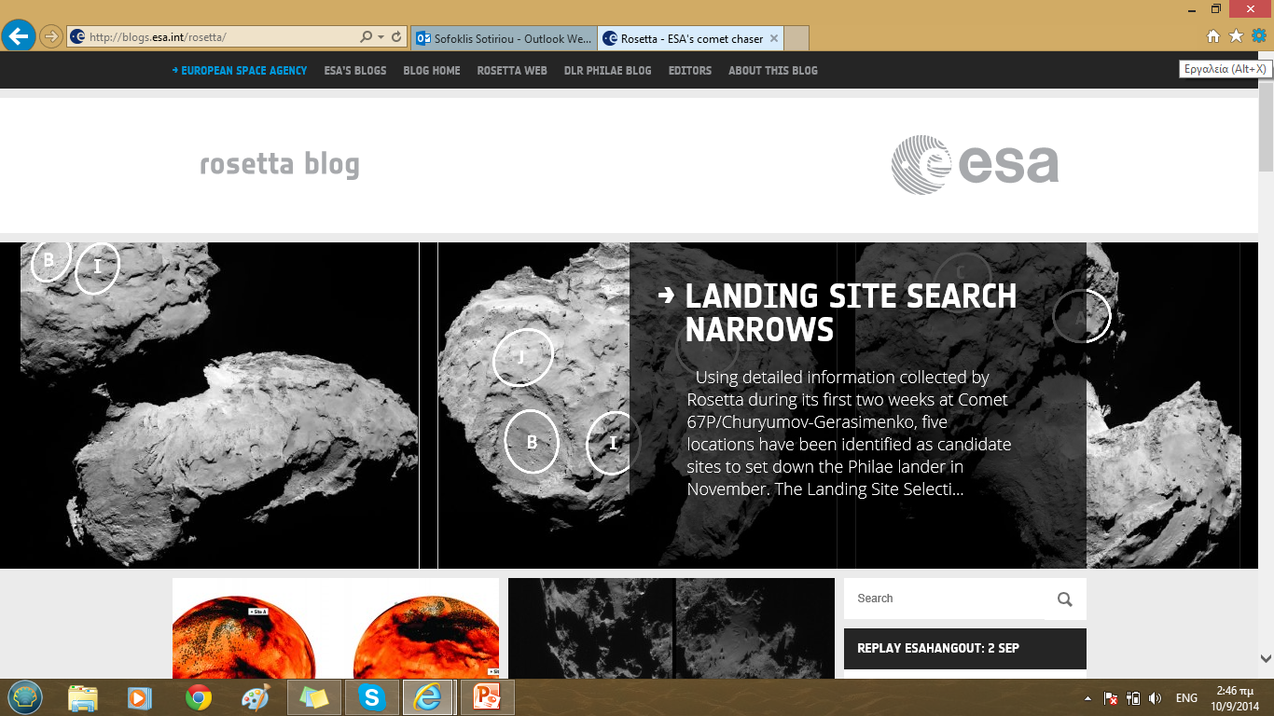
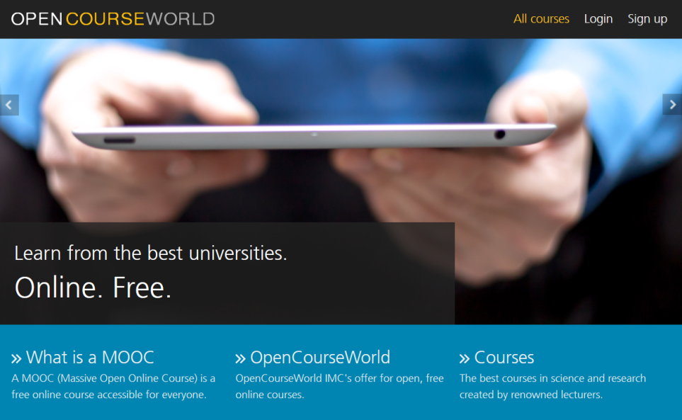
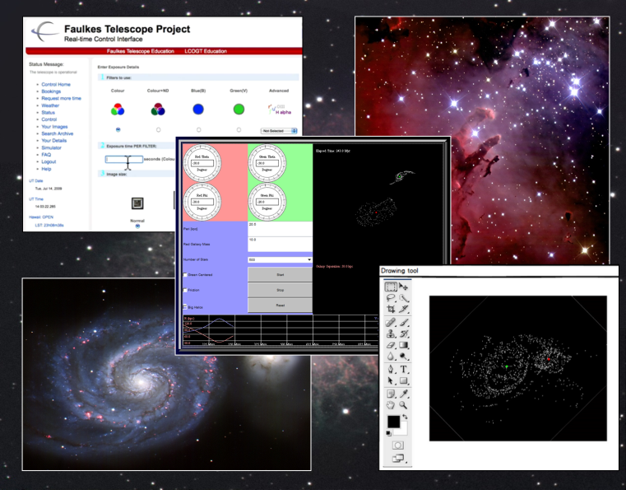
ESEA Moocs (using online labs)
For teachers who can’t participate in a workshop
For teachers in addition to a workshop
For all interested parties
Training in the use of online labs and the Portal
Theoretical background
About 16 hours work load
9
Notes:
Go-Lab MOOC „Using online labs in the classroom: an introductory course for teachers“ explains main inquiry learning concepts and trains teachers in using the Go-Lab Portal and online labs. It targets primarily teachers who are not able to participate in presence workshops, e.g., because of time and financial reasons, or if living in a country outside Europe. The course can be also interesting for scientists, online lab providers, educational providers, etc.
Connection to WPs:
WP4,5: the course gathers user feedback regarding the Portal and online labs (feedback forms after each course module)
WP6: course participants will join Go-Lab community
WP7: the course provides training for teachers helping them to integrate Go-Lab in their everyday teaching practice
WP8: the course gathers teachers’ feedback regarding particular inquiry learning scenarios and respective ILS, experiences of creating lesson plans, experiences of using the Portal and particular online labs, creation of own ILS, etc. (self-evaluation and feedback forms)
WP9: the course supports dissemination of the project; contributes to sustainability of the project, as the course can be offered also after the project finish.

Slide 10
2013-2015
8,000 schools
20,000 teachers
1,000,000 science education resources

Slide 11
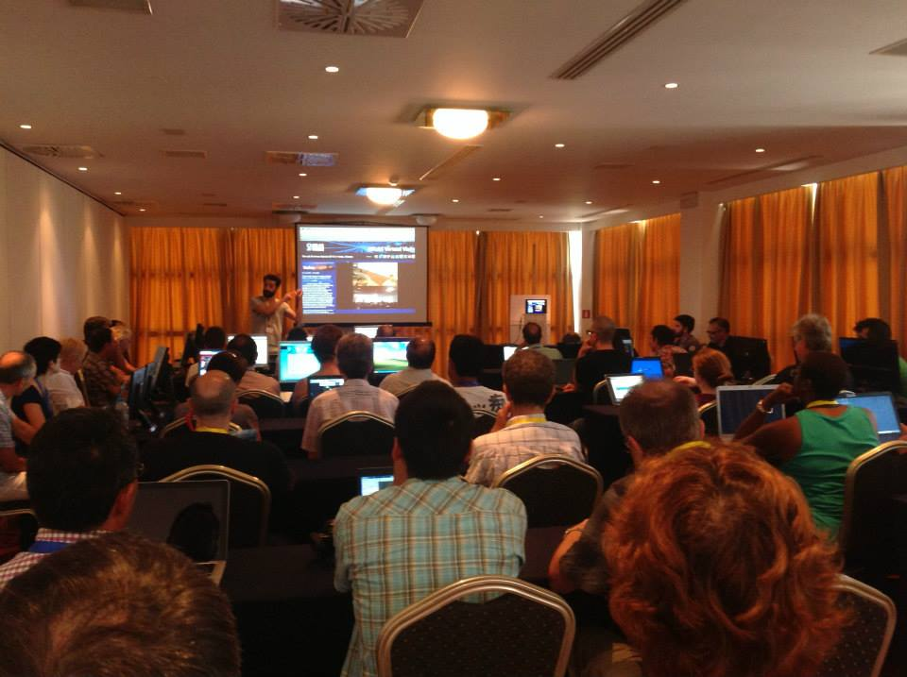
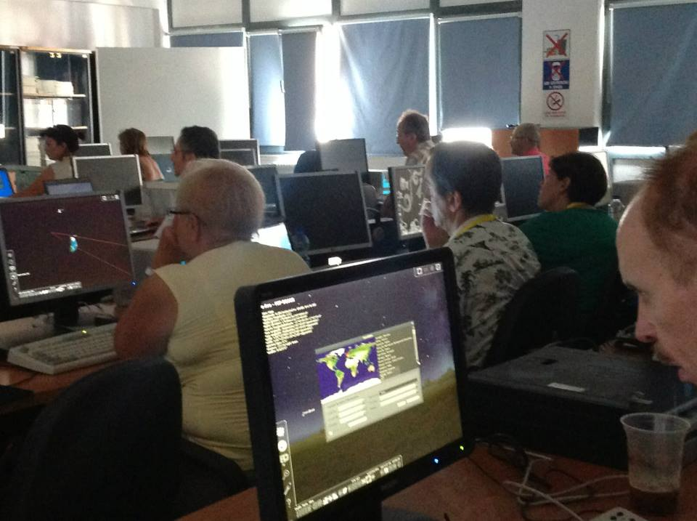
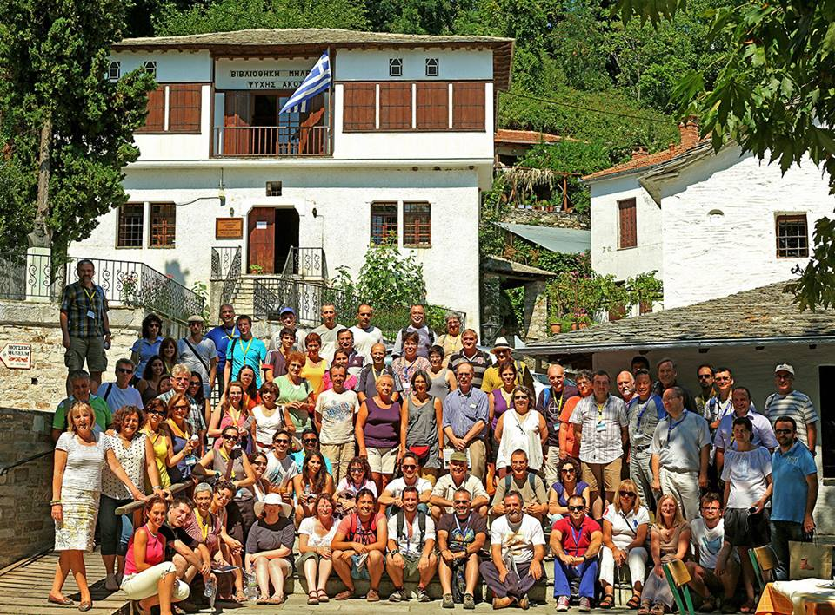
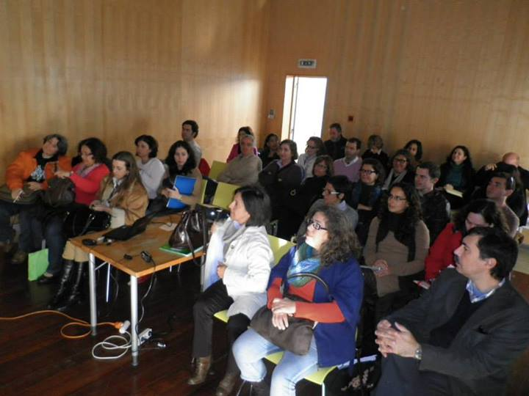
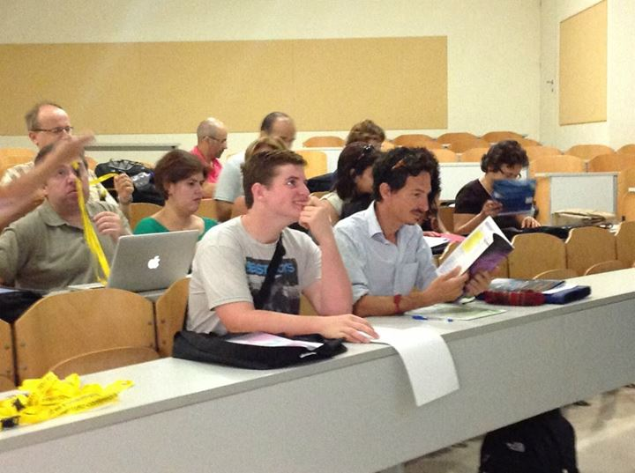
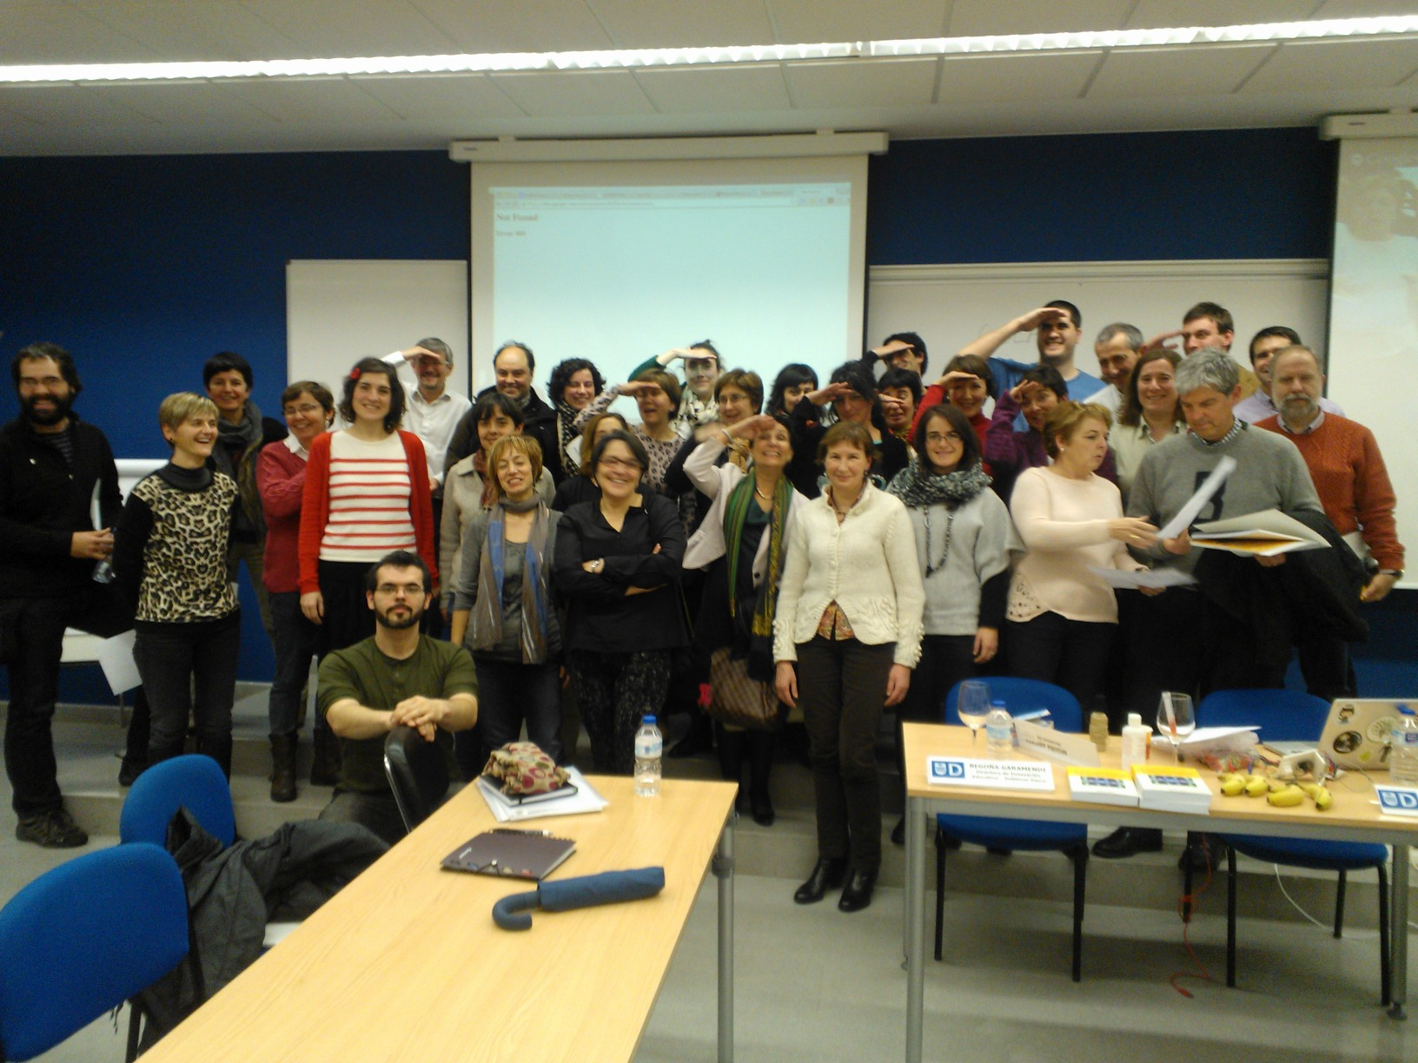

Slide 12
Educational Design
Resources
Teacher profiles
Metadata model
Mapping Algorithm
Selected resources
and tools

Slide 13

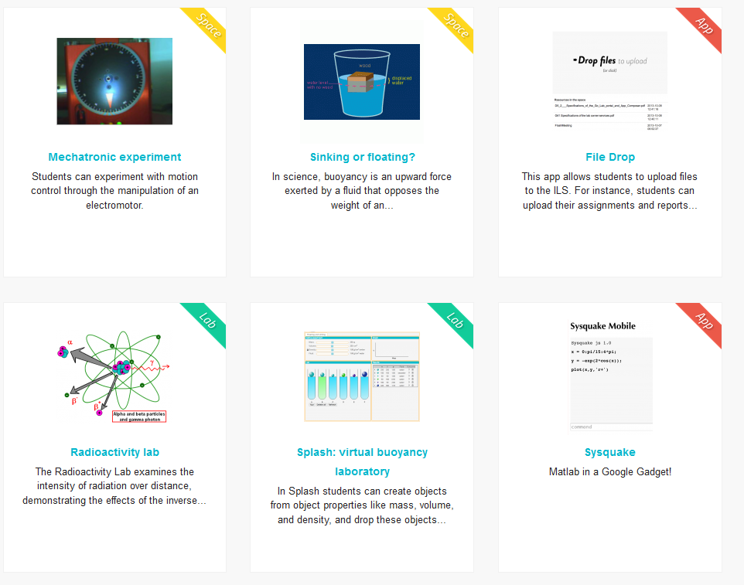
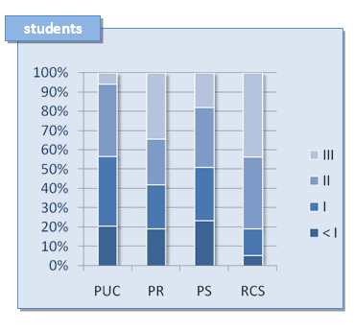
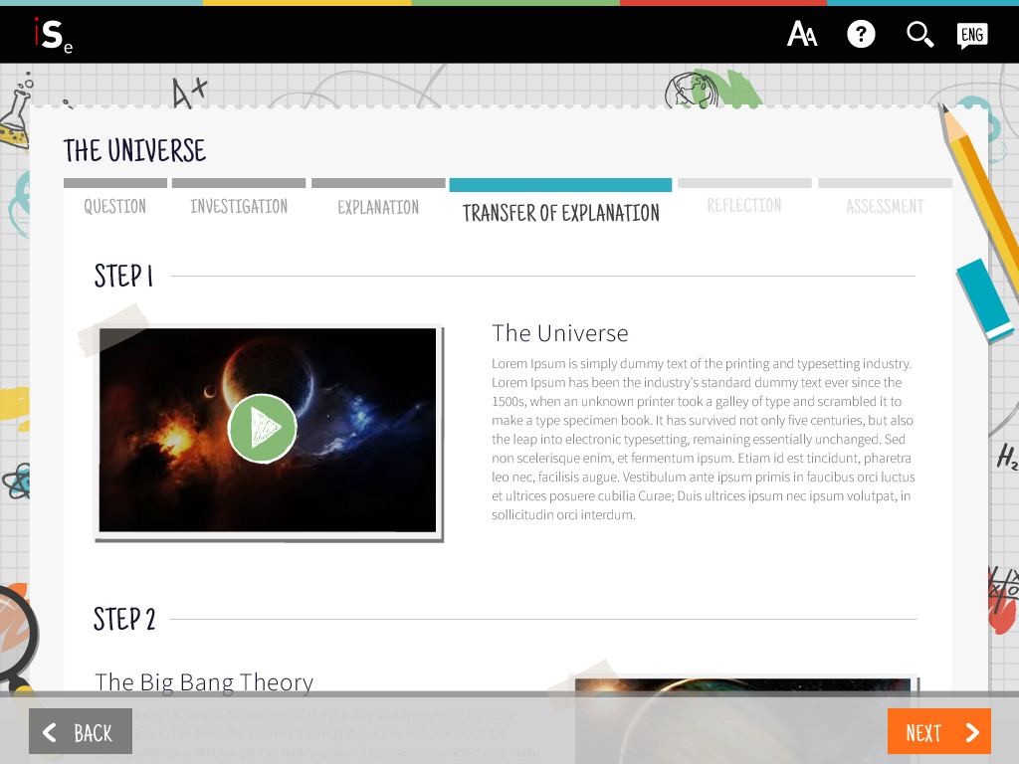
Authoring – Access – Deliver - Assess
Design Lessons/Scenarios by using existing resources and tools (such as online labs, AR/VR tools) and store them on the cloud
Deliver Lessons/Scenarios to students.
Collect Educational Data for student assessment based on PISA Framework

Slide 14
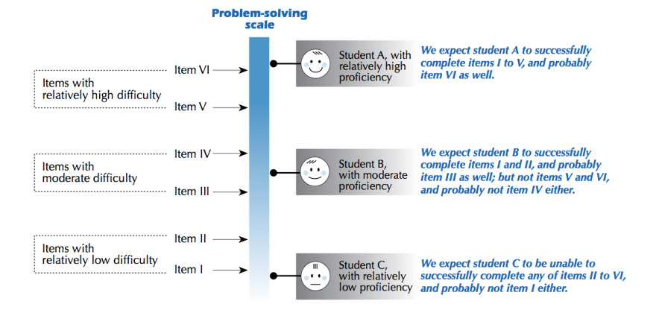
PISA 2012: Problem-solving
Relationship between questions and student performance:
(OECD 2014, p. 49)

Slide 15
Financial Support
Conceptual Framework (Funded by PATHWAY)
Initial Selection of Best Practices (Funded by PATHWAY)
Initial Version of the Repository (Funded by PATHWAY)
Development of advanced users interface (To be supported by INSPIRING SCIENCE EDUCATION – 2013-2016)
Continuous support of teachers communities (To be supported by Open Discovery Space – 2012-2015)
Coordination and support actions (meetings workshops) (To be supported by INSPIRING SCIENCE EDUCATION – 2013-2016)

Slide 16
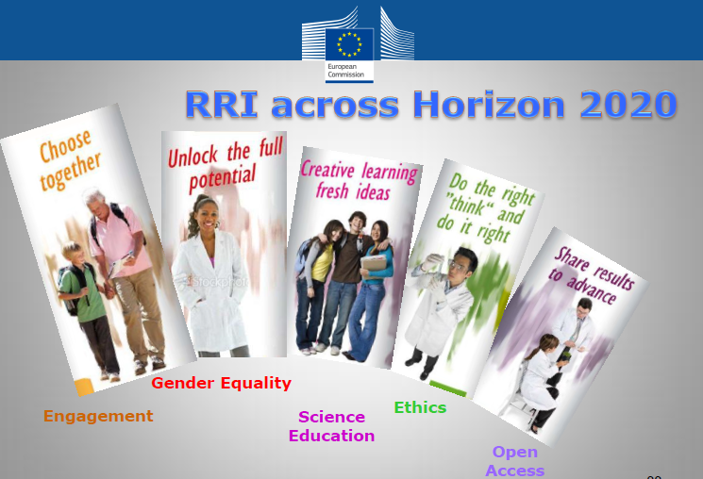
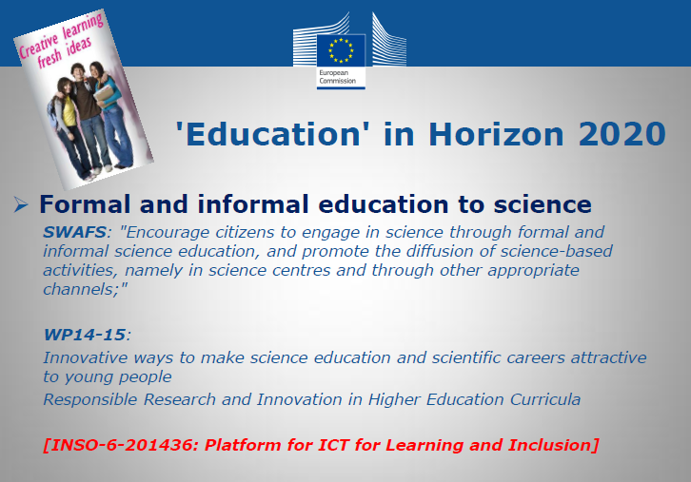
European Science Education Academy and Responsible Research and Innovation in HORIZON 2020
To promote the IY of Light to the educational communities across Europe
Main vehicle for active involvement in RRI actions
Deepen the relationship between science and society and reinforcing public confidence in science
Promoting science education, by making scientific knowledge more accessible, by developing responsible research and innovation agendas that meet citizens' and civil society's concerns.

Slide 17
Action Plan
Setting up the ESEA working group
Actions in 2014-2015 (Website, Communication Strategy, Portal population, workshops, hangouts, virtual visits, contests)
To coordinate the implementation of the Action Plan
To safeguard funding for the realization of the Action Plan
To organise three ESEA workshops (2014, 2015, 2016)

Slide 18
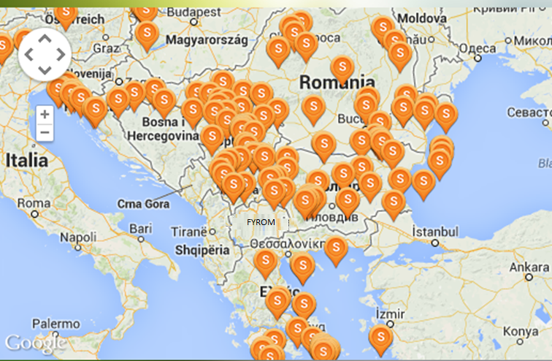
Steps Forward
Cooperation with National Science Societies
Organisation of workshops in different countries to further develop the proposed framework
Organisation and Support of Teachers and Students Contests
Cooperation with UNESCO in Balkan Countries
Presentations in Conferences and Workshops

